Slide 1
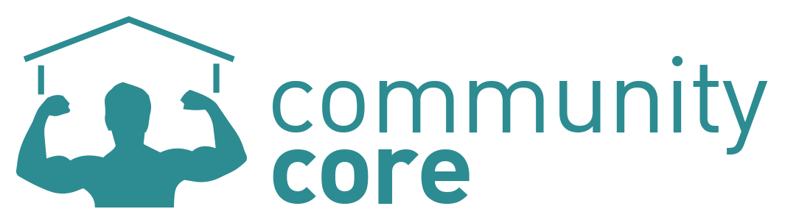
Build your community. Build your body. Build your life.

Slide 2
What we do
We are a fitness and lifestyle platform that provides an alternative to the typical gym. We connect non profit organizations with people who want to get physically fit while doing good for their community and we provide opportunities for socializing.

Slide 3
The Problem: People are not active
Intimidation
Boredom
Lack of social aspect – isolation
Expensive
Only 1 out of 6 people use their gym memberships
Americans spend north of $60 billion annually to try to lose weight
Notes:
Gym membership stat from Corporation for National and Community Service
According to data by Marketdata Enterprises, a market research firm that specializes in tracking niche industries, Americans spend north of $60 billion annually to try to lose pounds, on everything from paying for gym memberships and joining weight-loss programs to drinking diet soda.

Slide 4
The Problem: Lack of volunteers
Don’t know where to get started
Intimidating to do alone
Hard to maneuver the bureaucratic system
Wasted time getting started
Frequently, groups are wasted on meaningless tasks
The City of Buffalo is the 3rd poorest city in the United States
Notes:
Difficult to get matched up with opportunities
https://www.linkedin.com/pulse/real-reason-75-americans-dont-volunteer-greg-baldwin?trk=prof-post

Slide 5




We solve both problems
Notes:
We’re connecting local agencies with dedicated members of the fitness cub

Slide 6
Exercise and Empathize: What are the numbers?
In the Community
Walking on a treadmill – up to 356 calories per hour
Strength training – up to 266 calories per hour
In the Gym
Shoveling Snow – up to 600 calories per hour
Raking Leaves – up to 450 calories per hour
Painting a room – up to 357 calories per hour
Building a fence – up to 476 calories per hour
Gardening – up to 400 calories per hour
Mowing the lawn – up to 350 calories per hour
Hauling lumber – up 635 calories per hour
Source: Web MD, This Old House, Harvard Medical School

Slide 7
What We Offer
Personalized, customizable fitness plans
Organizing and outreach to local non-profits to fit them with a group of members passionate about their cause
On-staff fitness expert
User profile and calendar
A trained event “coach” that assists members with the community project and makes sure they are reaching their physical goals
Weekly and annual fitness reports
A sense of goodwill from helping the community
Membership into a welcoming, active and socially conscious local community with sponsored events
Discounts from local co-ops – think Lexington Co-Op
Notes:
User profile: Results and strength growth over time, interests,
Connect fitness activities of non profits with people that are looking for these.
We have a web interface, online experts, and organization matching based on your preferences and fitness needs

Slide 8
Demo
Notes:
This should be the demo
Everybody should get fit, but we’re targeting adults that are looking for different ways to be active.
Take Sheri Frederickson. She works full time as an ESL instructor. She can’t do push ups for her life. She finds bench presses too sweaty, public pools too murky, and the thought of socialzing
Bill and Melinda Yates, an couple of empty nesters that have some free time now that all the kids are gone and have been told by their doctor to get more active. They’re excited to find a system where we can tailor a custom fitness plan for them and they can work with many different organizations to add variety to their activities.

Slide 9
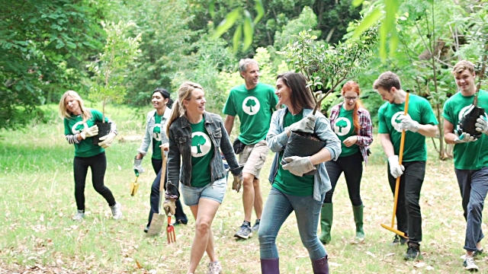
You are a part of a community
We provide fitness activities, and you work alongside others that are likeminded
We organize periodic social activities for the entire community
We connect up with lifestyle events in the community
Community engagement with recipe blogs and other event notices

Slide 10

The Local Market
175,000 people in Western New York have gym memberships
There are already 21,000 people in Western New York volunteering their manual labor
Interest is high - over 60% of survey respondents said that they would pay for this service as a replacement or supplement to gym memberships
Notes:
Find percentage of population that has membership (among others, http://www.statista.com/statistics/246959/share-of-us-population-with-health-club-membership/)
Find percentage of WNY population that has membership = 15% of Erie county population (900k) = 135000 memberships in WNY
2/3 of those people want to get fit but don’t use their membership (http://www.statisticbrain.com/gym-membership-statistics/) (2/3rd of 135k = 90k)
(2/3 instead of 4/5 or 5/6 because buffalo is a fit city)
Buffalo labor stat from the federal Corporation for National and Community Service

Slide 11
Who pays for all this stuff?
Two main revenue streams
Monthly Membership Dues (80%) – Average price for gym membership is $40-$58, we’re competitively priced at $30
Community Organization Fee (20%) – The various community organizations will pay fees in order to get large groups of helpers
Third, and bonus, source of revenue is sponsorships
Notes:
Some of membership dues goes to charity

Slide 12
Financial projections
Projected Revenue
Assumptions:
Expansion to multiple cities in second year.
Average of 15% month over month user growth.
Focused on growth over profit in first five years.
Cash flow positive within 12 months.
Include taxes but not interest, depreciation, and amortization.
 | 2016 | 2017 | 2018 | 2019 | 2020
Revenue | $95,287 | $306,191 | $918,274 | $2,957,914 | $6,407,472
Users | 405 | 1,386 | 4,351 | 13,036 | 23,410
Expenses | $78,783 | $288,549 | $651,721 | $957,667 | $1,895,321
Profit | $16,504 | $17,642 | $266,553 | $2,000,246 | $1,895,321
Notes:
Cash flow positive in first year
Assume 15% month over month user growth
Expansion to other markets in second year

Slide 13
Exit / Ask
Acquisition by larger company interested in a more holistic approach to fitness and lifestyle
Fitness Plays: LA Fitness, World Gym, 24 Hour Fitness, etc.
Lifestyle Plays: Facebook, Apple, Google, etc.
We are seeking $50,000 in initial investment for:
Initial 6 month development cycle (stealth mode)
Operating expenses through first six month of revenue generation
In exchange we are offering 40% stake in the company
$125,000 valuation.
Notes:
It doesn’t cost much to get a group of people together and go and help out an organization. Only once somebody signs up and pays, do we need to connect with a fitness pro to tailor a plan and have them facilitate the event. Based on their hourly wage, can pay them with only 10 members.
In the interest of doing things that don’t scale, manualized everything that will eventually be automated.

Slide 14
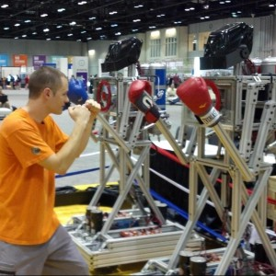
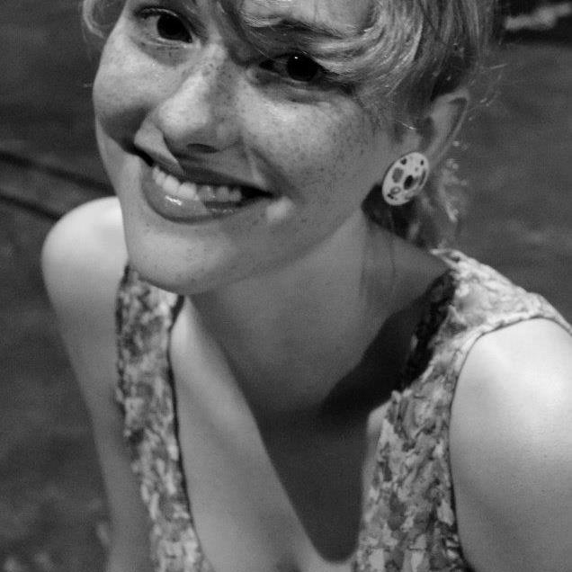

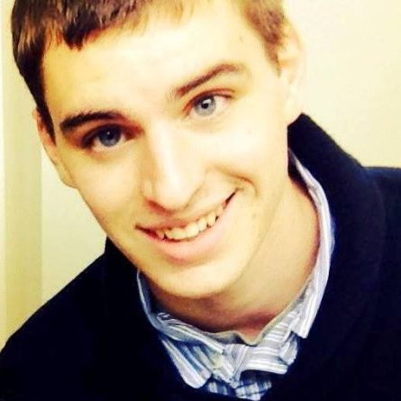
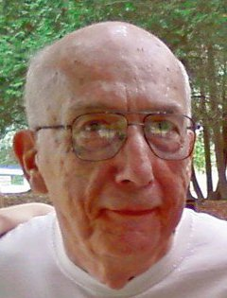
Who we are
Mike Kozelsky
• Software technologist and tinkerer
• Studied computer science at UB
Madelaine Britt
• Studies Environmental Design and Political Science at UB
• Experienced in community development
• Cofounder of CoLab
Victor Konshin
• Serial Entrepreneur
• Studied Physics at the University of Buffalo
• Experienced developer
Jonathan Hutchison
• Studies web design at Daemen College
• Intern at Z80 Labs
• Minor in entrepreneurship
Charlie Wertz
• Retired professor of Information Systems
•Extensive industry experience
Notes:
Questions?

